Slide 1

Copper global landscape and challenges for new projects
Juan Brihet – Senior Consultant
30th July 2025

Slide 2
Agenda for today…
Global supply and demand drivers
Challenges for project development
Key takeaways

Slide 3








Strategy built from a powerful knowledge-base
Reliable data based on transparent methodologies
Data Excellence
Events and Training
Expert thought leadership
CRU
Knowledge Base
Access to analyst insight
Analytics
and advisory
Analysts
Sustainability
Custom advisory for strategic projects
Consultants
Economists
Macroeconomics meets commodity markets

Slide 4
Global supply and demand drivers

Slide 5
Long-term demand story remains strong
Global refined copper consumption, 2015-2050, Mt
Cumulative copper metal demand by sector, 2025-35, Mt
DATA: CRU

Slide 6
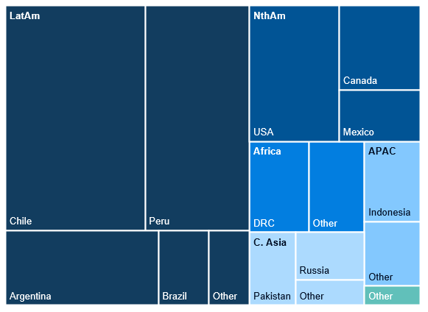
Supply gap to 2035 reflects a unique opportunity to invest in copper
Mine production (committed) and potential (uncommitted projects), 2020-2035, kt
Sources of as-yet uncommitted capacity, 2025-2035
Supply gap
DATA: CRU

Slide 7
Production growth in Chile will mainly come from new projects
Chile’s copper mine production*, 2007-2026, Mt
Production from mine projects in Chile, kt Cu
DATA: CRU. Note: *Forecast before disruption or probability adjustments.

Slide 8
Project development challenges

Slide 9
More complex copper deposits and high Capex overrun
Production weighted ore grades, % Cu
Capex Overrun Cu Projects, %
DATA: CRU

Slide 10
Copper projects take longer to develop
Average duration of mine development by stage and by era (years)
Tier 1 mine projects
Average time per stage in the development of mining projects (years)
10.4
11.7
DATA: CRU

Slide 11
Regulatory framework dictate projects’ pace
Total potential investment in mining projects submitted to Chile’s Environmental Assessment Service by year, $M (nominal)
DATA: CRU

Slide 12






The human factor: social license and contractor availability
Social license
Available contractors
Regional impact
Key in some countries (e.g., Peru)
Differences for brownfield vs. greenfield projects
Global impact
Limited availability of EPC contractor (manpower to build projects)
Copper projects to compete with other industries for these scarce resources
DATA: CRU. Note: EPC stands for engineering, permitting and construction.

Slide 13





Key takeaways
Demand
Long-term demand for copper remains strong and key GET drivers are EVs and renewables, but no less important than grid infrastructure
Supply
Copper supply gap continues to drive incentives for industry investments, with more than half of global uncommitted capacity located in Latin America, mainly in Chile, Peru and Argentina
Projects
5 (or 6) key challenges for new projects: lower grades, capex overrun, stages development time (scoping to commissioning), regulatory framework, social license… and contractor availability?
Risks
to the outlook
Downsides: geopolitical tensions, tariffs and trade war (globally); country elections, political framework (regionally)
Upsides: Decarbonization & green transition; growth and M&A in the sector; metals value chain protectionism

Slide 14
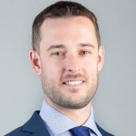
Thank you.
Juan Brihet
Senior Consultant, Santiago
Email: juan.brihet@crugroup.com
14

Slide 15







Complexity into clarity - unlocking strategic advantage in the commodity markets with CRU Consulting
What do we do?
Who do we help?
How do we help?
Why are we different?
CRU Consulting operate in an advisory role, supporting clients in strategic and transactional decision making.
We combine market, technical and commercial knowledge in one complete offering to solve the mining and metals industry’s most pressing questions.
Our clients are stakeholders in the commodity markets.
Whether you are a government defining policy for years to come, or a producer taking the next step in unlocking value, we are here to help.
For case studies – scan or click the QR code:
Better decision making – informed by decades of experience
Market advantage – early signals on commodity market developments
Risk identification & mitigation – planning for uncertainty
Value creation – actionable advice on how to unlock future value
Fiercely independent – we are not afraid to voice our opinion
Pioneers in any market – no market is out of reach
Empathy – genuine duty of care for our client’s problems
Arms length – we are not here to replace in house services
Diverse team – a unique blend of skills and industry expertise
 | Backed by CRU’s market leading Data, Insight and Communities

Slide 16






CRU Consulting operate in a range of practice areas to find solutions for our client’s questions
Strategy | Transaction Advisory | Negotiation Support | Sustainability | Commodity Research | Expert Witness
Corporate Market Entry Decarbonisation Diversification Procurement Product Marketing Expansion and Growth | Commercial Due Diligence Market Due Diligence M&A Advisory (Sell and Buy Side) Red Flag Reports Valuation | Fair Value Pricing Contract Review and Structuring Stakeholder and Investor Management | Policy and Regulation Emissions Benchmarking Climate Scenarios Risk Management | Primary Research Long Term Outlooks Scenario and Sensitivity Analysis Niche Markets | Data Support Litigation Support

Slide 17
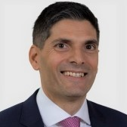
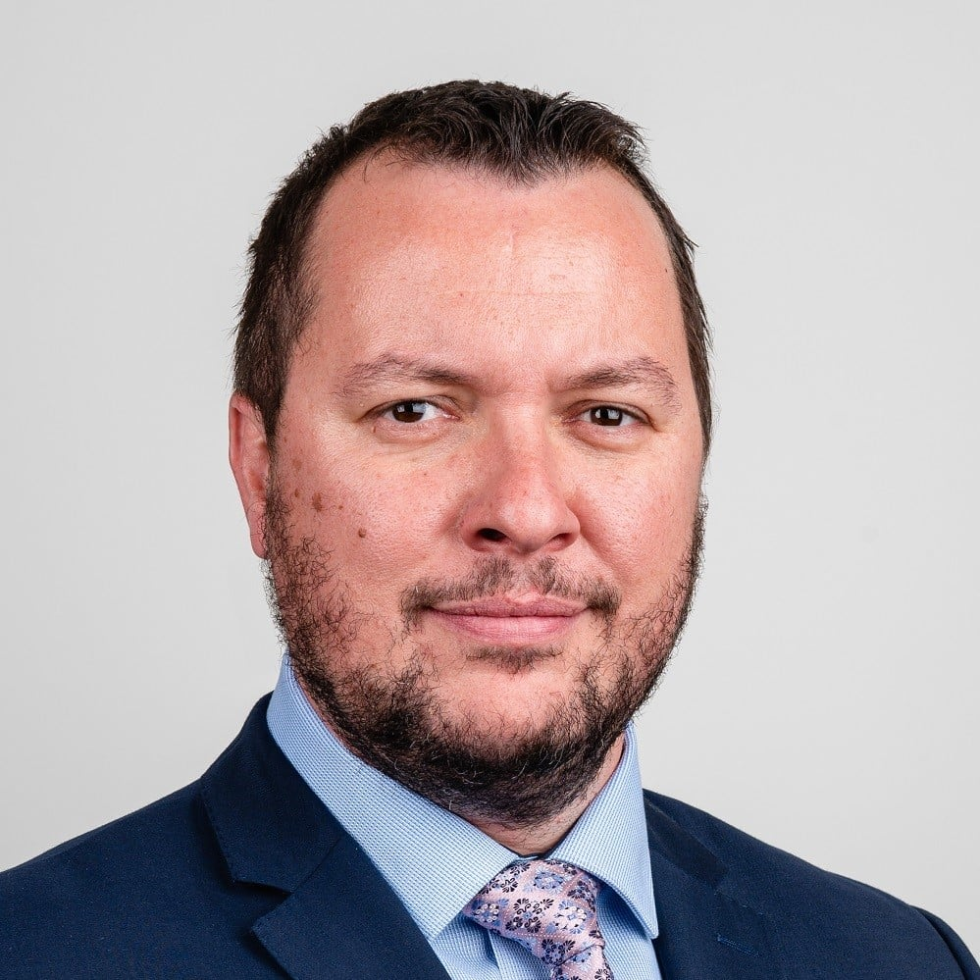
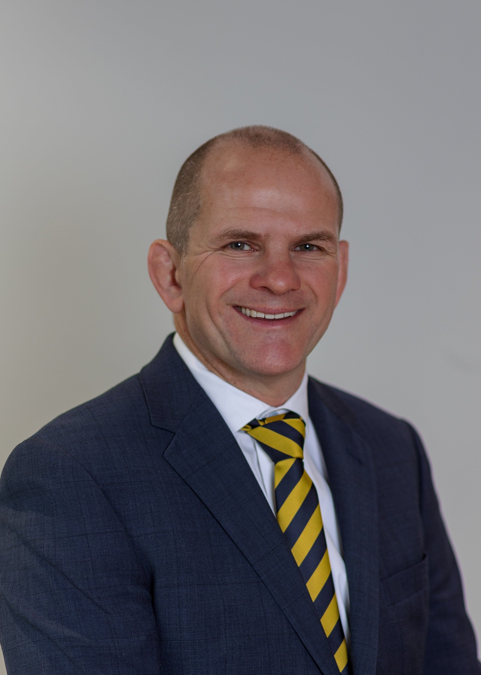
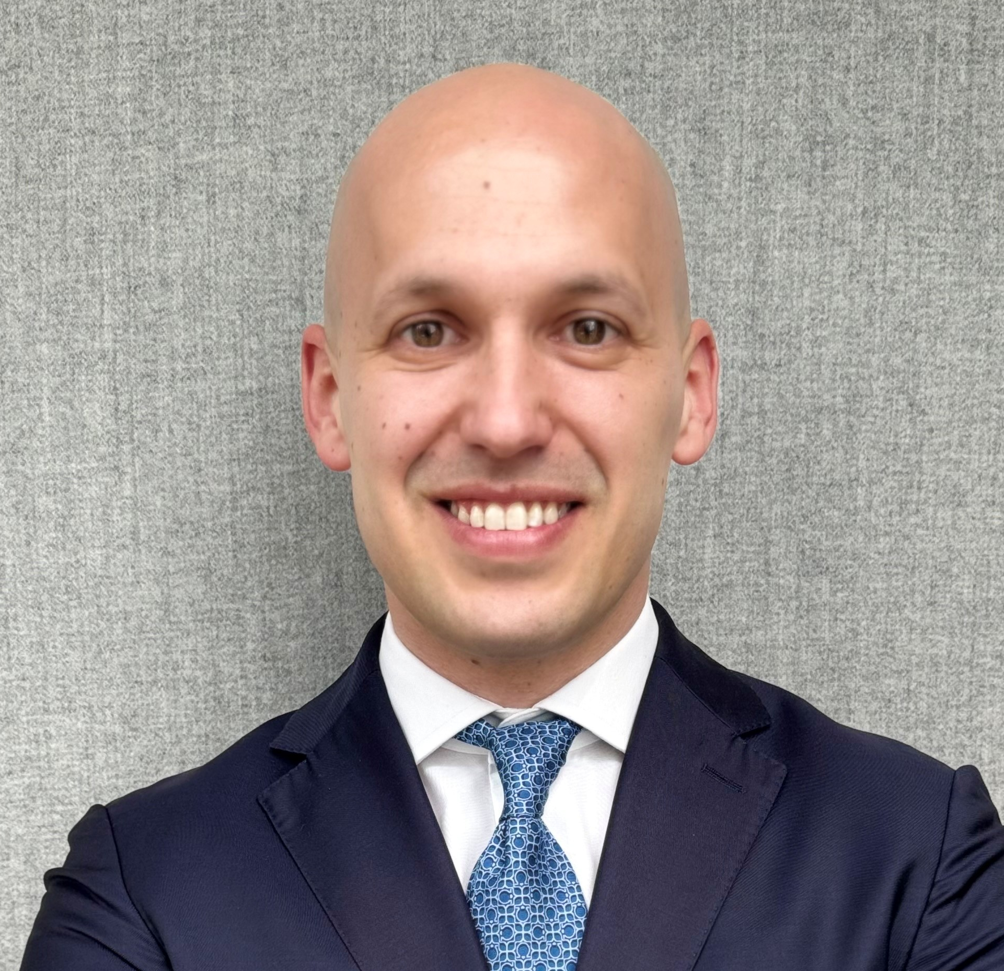
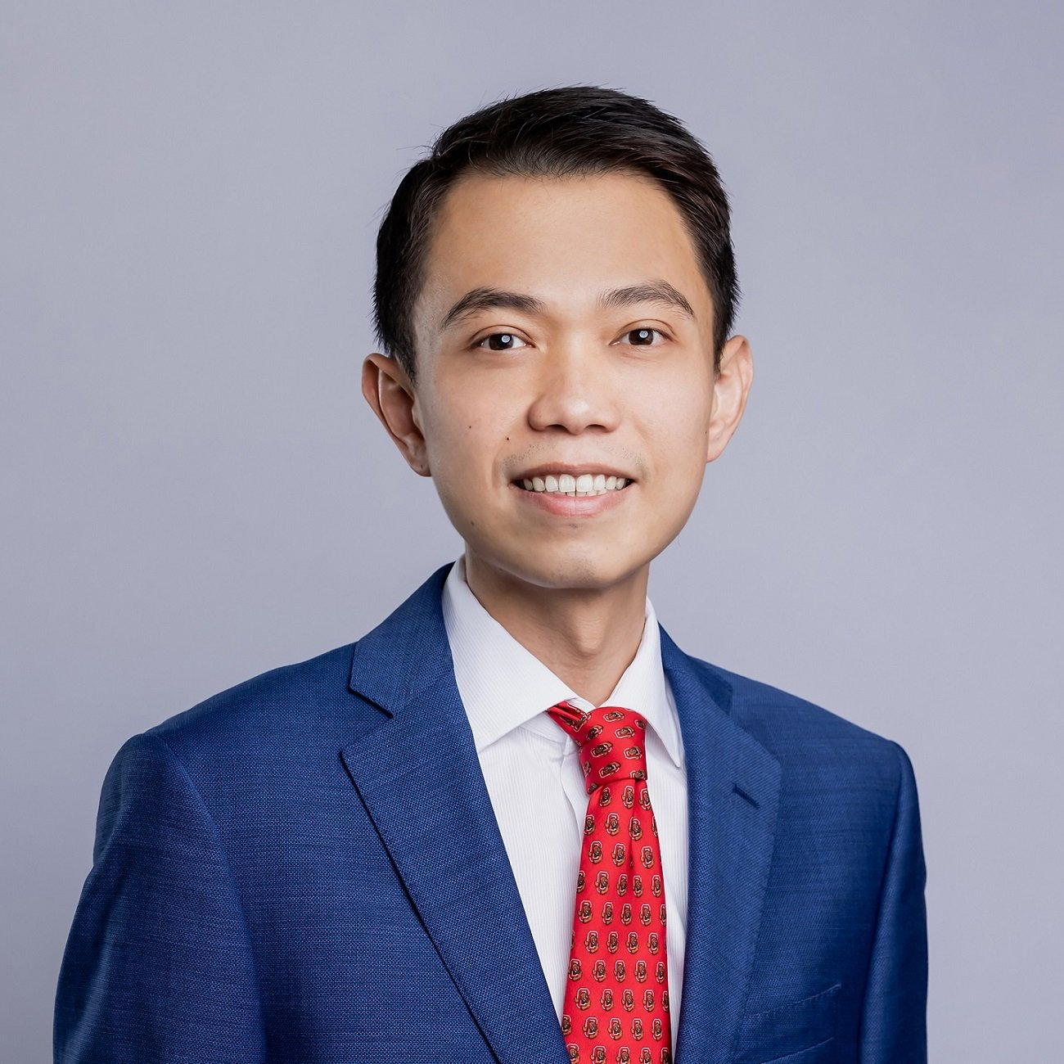
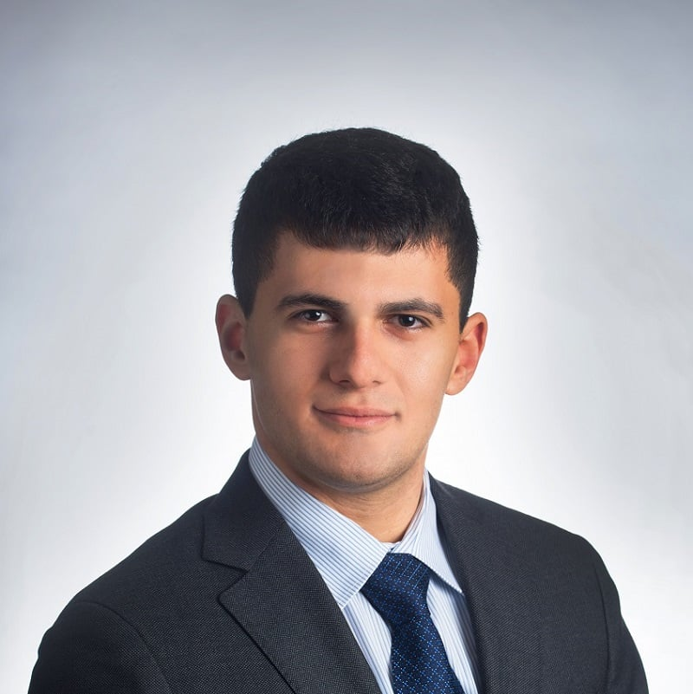

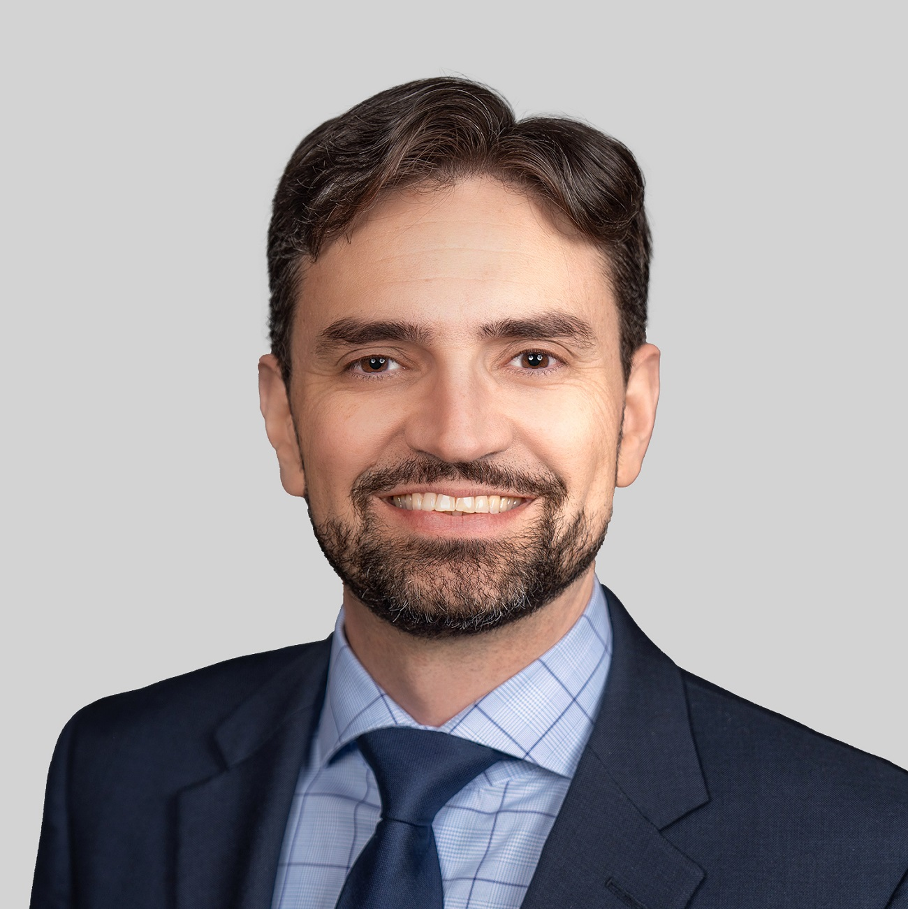
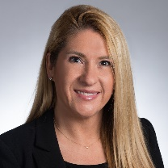
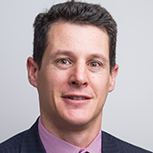

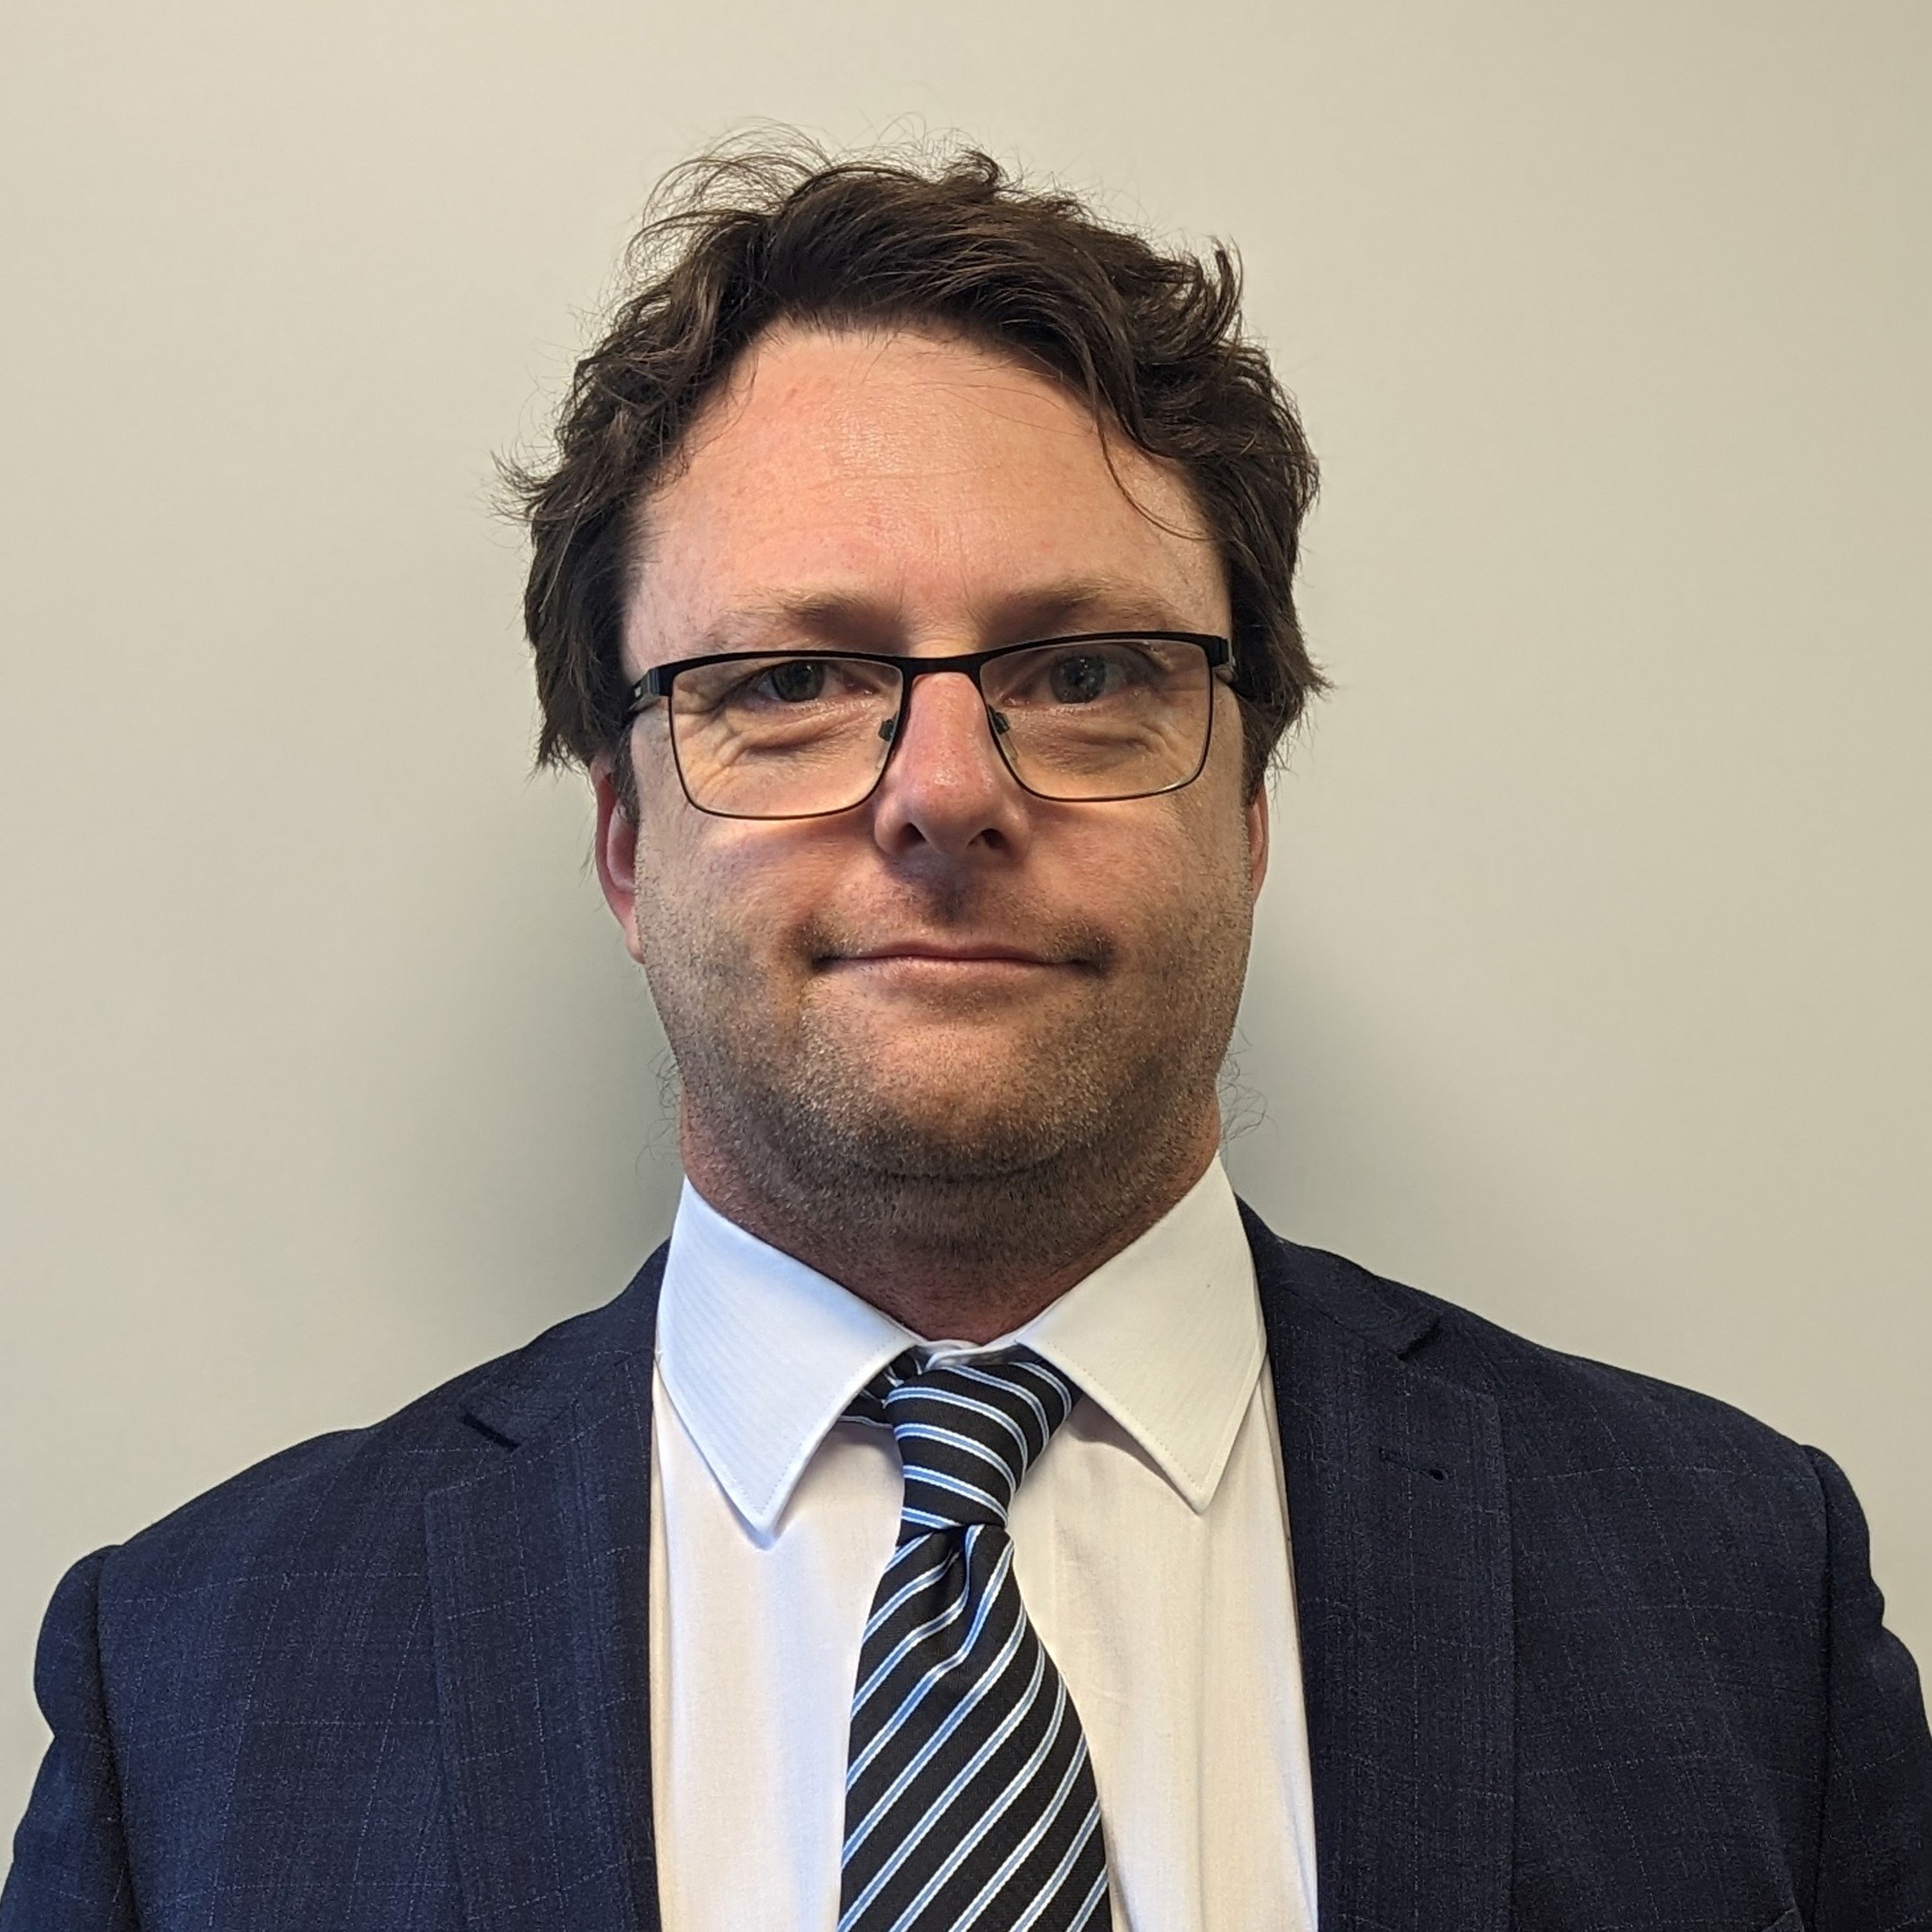
We are positioned to deliver advice across the globe
Decades of experience in advising on the commodity markets
In touch with what matters in each region
Victor Rodriguez
Managing Director
Ionut Lazar
Principal - London
Gareth Beese
Head of Consulting - EMEA
Josko Kandido
Principal - London
Ibrahim Yucel
Principal - Pittsburgh
Josefa Carrere
Principal - London
Taylor Shively
Principal - Denver
Lynn Lupori
Head of Consulting - Americas
Alex Tonks
Head of Consulting - APAC
Strategically placed for in- person conversations
Francisco Acuna
Principal - Santiago
Victor Chin
Principal - Singapore
 | CRU Offices
Jason Needham
Principal - Sydney

Slide 18
CRU Legal Notice
This presentation is private and confidential. It must not be disclosed in whole or in part, directly or indirectly or in any other format without the prior written permission of CRU International Limited.
CRU International Limited’s responsibility is solely to its clients and its liability is limited to the amount of the fees actually paid for professional services.
Although reasonable care and diligence has been used in the preparation of this presentation, we do not guarantee the accuracy of any data, assumptions, forecasts or other forward-looking statements. CRU cannot be held responsible for the views of third parties or any associated data and charts provided. Where references are made to CRU Prices, our methodologies are available on www.crugroup.com We accept no liability to third parties, howsoever arising.
CRU follows all applicable information security compliance and the relevant laws and regulations on personal information protection. Our privacy policy can be viewed at https://www.crugroup.com/privacy-policy/
Copyright CRU International Limited 2025. All rights reserved.

